Slide 1

Artificial Intelligence - ENCS3340
Course Project 1 Search Algorithms for Route Navigation
Tariq Odeh -1190699
Yousef Hammad – 1170625
Instructor's Name: Dr. Adnan Yahya

Slide 2

Determine the algorithm that we will implement.
Create an input file.
Read the input file and built the graph.
Building the algorithms using (JAVA) language.
Preparing the menu and the method of printing to be easy for the user.
Implementation steps

Slide 3

(based on last digit of the least student id in the team mod4) 1. Depth First Search (DFS). 2. Greedy algorithm. 3.A* search Aerial heuristic and Walk real cost & A* search Walk heuristic and Car real cost. 4. Extra algorithm (Breadth First Search (BFS), Uniform Cost Search method(UCS)).
Determine the algorithm that we will implement.

Slide 4
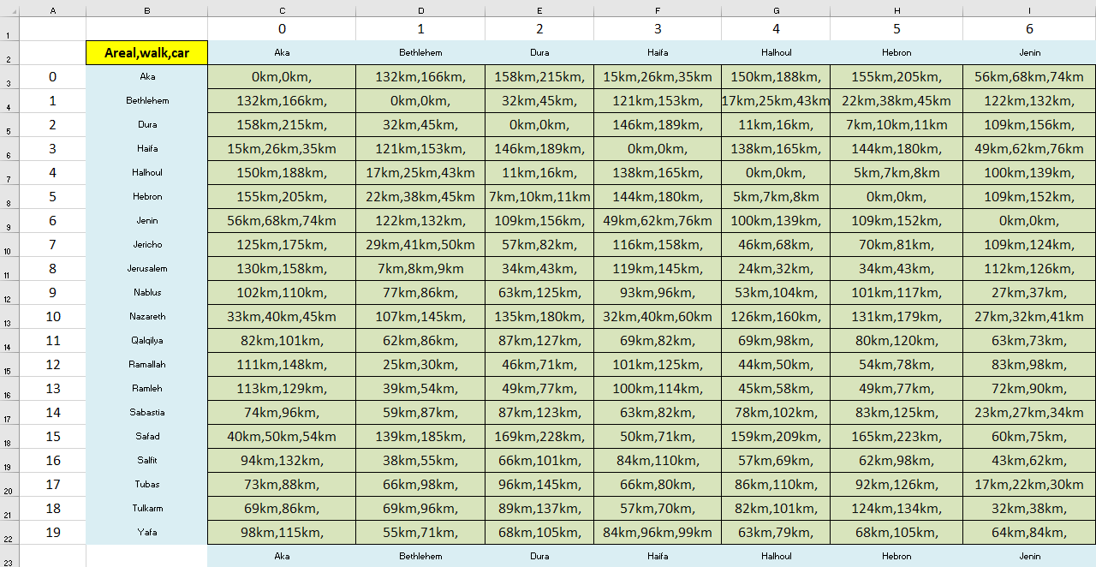
Create an input file

Slide 5
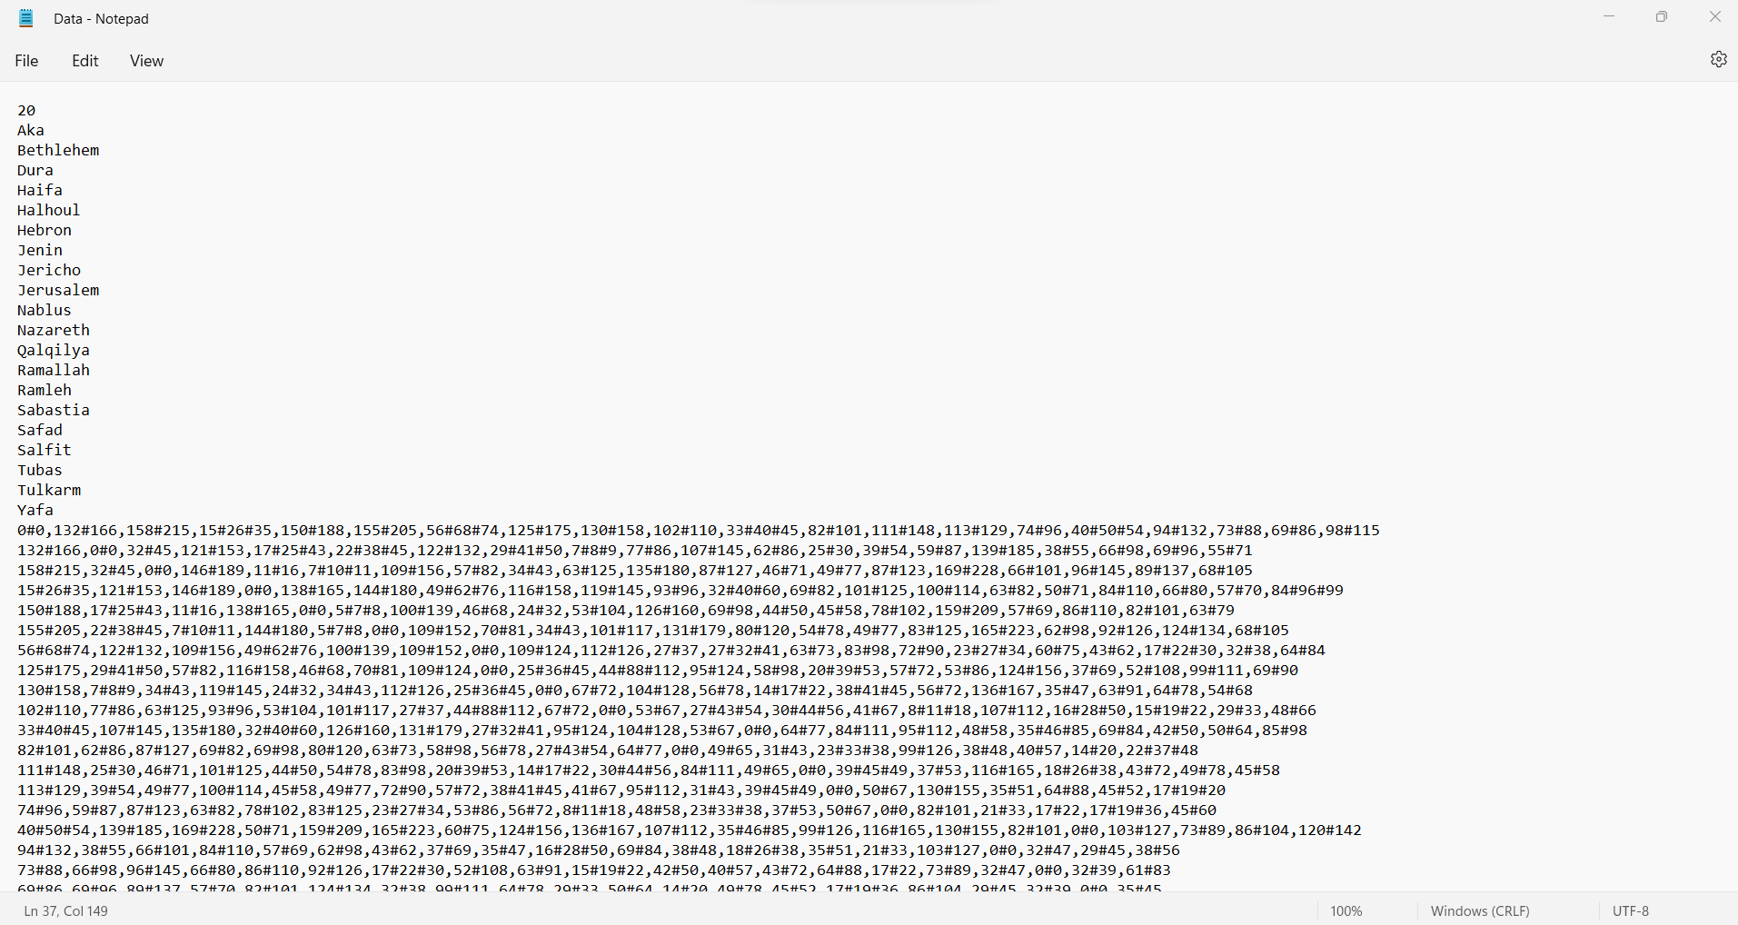
Read the input file and built the graph

Slide 6
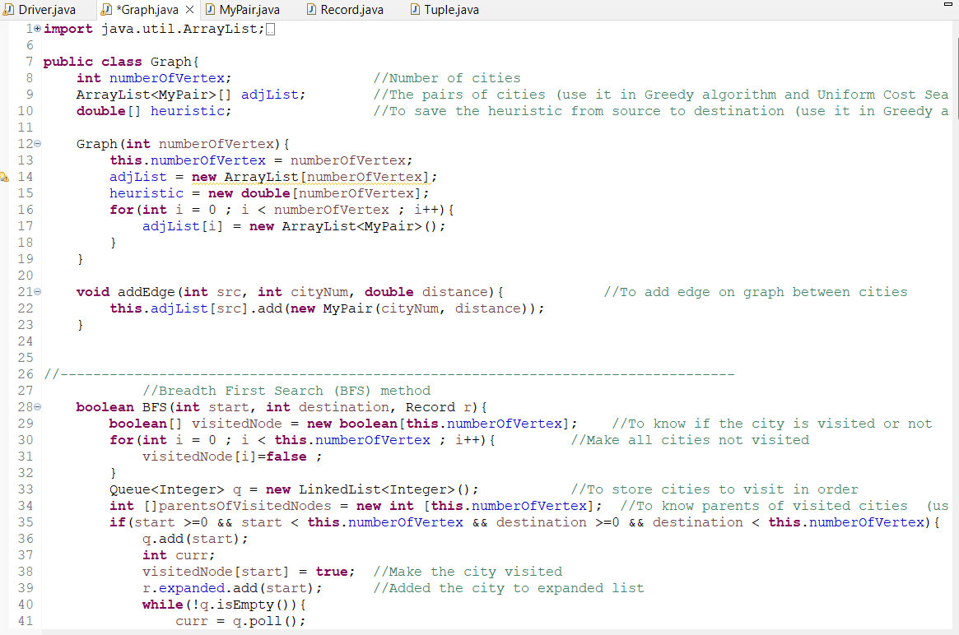
Building the algorithms

Slide 7
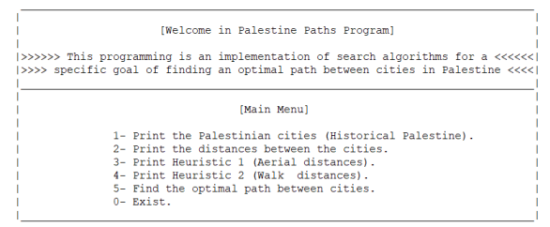
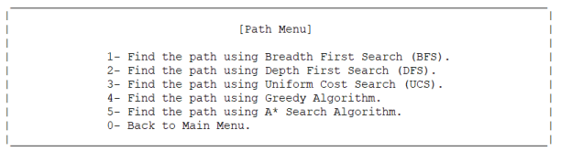
Preparing the menu and the method of printing to be easy for the user

Slide 8

How to Run the code! Examples!

